Slide 1

The Redesigned SAT and the ACT:
What You Need to Know
Chris Piane
Executive Director
Chris.Piane@review.com

Slide 2
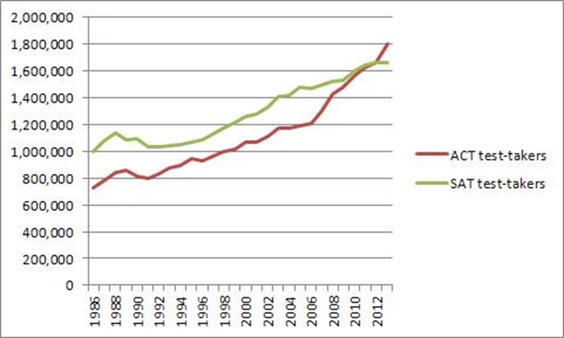
Why Did the SAT Change?
ACT is winning the test race!
ACT is more popular than SAT nationwide.
More states using ACT as high school exit exam

Slide 3

A Classic Battle
Business to Consumer
Business to Business

Slide 4

The sincerest form of flattery…
No penalty for wrong answers
4 answer choices on multiple-choice questions
Essay is optional and comes at the end
Include advanced math topics (Algebra II and Trigonometry)
Grammar questions look almost exactly the same and include punctuation
Without essays, both are about 3 hours
Require interpretation of charts and graphs
Say they are testing science, but don’t really test science
Give all sorts of sub-scores that few will really care about
Curricula-aligned tests primed for use by states
How are the ACT and the New SAT similar?
.

Slide 5

Admission testing
The ACT and New SAT are different variations of the same basic thing.

Slide 6
Same nuts, different flavors
 | ACT | New SAT
Tests math introduced in 8 – 11th grades | ✓ | ✓
Tests reading comprehension | ✓ | ✓
Tests grammar | ✓ | ✓
Aggressively timed | ✓ | ✓
Primarily multiple choice | ✓ | ✓
Norm-referenced, “bell-curved” | ✓ | ✓
Required by most colleges | ✓ | ✓
Reflects how well you do in school
ACT
New SAT

Slide 7
Changes to the SAT
 | Old SAT | New SAT
Length | 3 hours, 45 minutes | 3 hours, 50 minutes (with essay)
Timing | Many short sections | Few longer sections, More time per section
Overall | Less content, but trickier language | Harder content, but more straightforward
Scoring | 200-800 per section and then added together | 200 – 800 for Math and 200 – 800 for Reading/Writing
Penalty for Wrong Answer | Deducts ¼ point for every wrong-multiple choice answer | No penalty for wrong answers
Answer choices on multiple choice | 5 | 4
Calculators | Can be used on all math questions | Can be used on some math questions, but not on others
SAT
New SAT

Slide 8
Structured and defined…
ACT
Section | Section Type | Time per Section
1 | English | 45 minutes
2 | Math | 60 minutes
3 | Reading | 35 minutes
4 | Science | 35 minutes
5 | Essay (optional) | 40 minutes
New SAT
Section | Section Type | Time per Section
1 | Reading | 65 minutes
2 | Writing and Language | 35 minutes
3 | Math – no calculator | 25 minutes
4 | Math - calculator | 55 minutes
5 | Essay (optional) | 50 minutes
What Math topics are tested?
Notes:
Seconds per question

Slide 9

The NEW PSAT
Scored 320-1520
  Sum of Evidence-Based Reading and Writing and Math (160-760)
“Vertical Learning Ladder” to SAT
  Scores comparable between PSAT/SAT
7 Subscores (1-15)
2 Cross-Test Scores (8-38)

Slide 10
Relationship to SAT
Based on Redesigned SAT
Differences
  Reading: 5 fewer questions, 5 fewer minutes
  Writing and Language: Nothing!
  Math: 10 fewer questions (4 fewer Additional Topics), 10 fewer minutes
  No Essay

Slide 11
National Merit Scholarship
PSAT is also the NMS Qualifying test (NMSQT)
Junior year test counts!
  Top 3% of Juniors are chosen
NMS Selection Index is NOT the PSAT score

Slide 12
National Merit Scholarship
Score calculation:
  3 Test Scores (Reading, Writing and Language, Math) 8-38
  Add 3 scores, multiply by 2
Range 48-228
  Old NMSQT 60-240
Qualifying score varies by state

Slide 13
National Merit Scholarship
Eligibility requirements:
  High School Student
  Test in 3rd year of grades 9-12
  U.S. Citizen OR intending to become citizen at earliest possibility

Slide 14
Score Report Page 1

Slide 15
Score Report Page 2

Slide 16
Score Report Page 2

Slide 17
Score Report Page 2

Slide 18
Score Report Page 3

Slide 19
Score Report Page 3

Slide 20
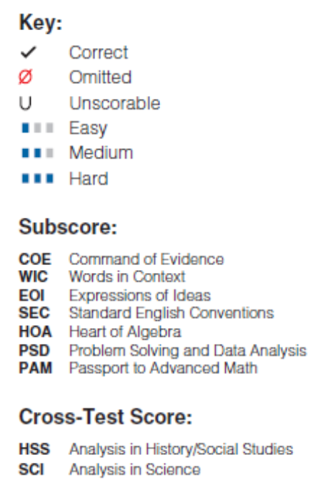
Score Report Page 4

Slide 21
New SAT Score Release Delay
Scores for the first administration in March 2016 will be held until AFTER the May 2016 administration
Allows the College Board to better scale the scores (bigger data set)
.

Slide 22
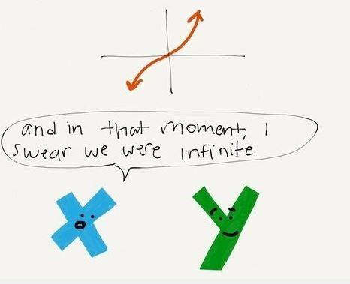
Math

Slide 23
So what’s new?
Content Area | ACT | rSAT
Solve single variable equations | ✓ | ✓
Use ratios and proportions | ✓ | ✓
Solve single & multistep problems involving percents, measurement/unit conversion | ✓ | ✓
Analyze a scatterplot |  | ✓
Compare linear growth with exponential growth |  | ✓
Trigonometry | ✓ | ✓

Slide 24

Different, not necessarily harder
More Algebra II/Pre-Calc Content
Fewer tricks
A lot less basic geometry
More reading
More charts and graphs
Still very coachable

Slide 25
Math Topics – Same topics, different spin
New SAT
SAT
1. The function f is defined by f(x) = 2x³ + 3x² + cx + 8, where c is a constant. In the xy-plane, the graph of f intersects the x-axis at the three points (-4, 0), (1/2, 0), and (p, 0). What is the value of c ?
A) –18
B) –2
C) 2
D) 10
2. If the function f is defined by f(x) = 3x + 4, then 2f(x) + 4 =
(A) 5x + 4
(B) 5x + 8
(C) 6x + 4
(D) 6x + 8
(E) 6x + 12
ACT
3. A function f(x) is defined as f(x) = -8x². What is f(-3) ?
A. –72
B. 72
C. 192
D. –576
E. 576
Notes:
Official ACT question from 2014 practice guide actstudent.com

Slide 26

Reading

Slide 27
Reading Comprehension
 | ACT | SAT | New SAT
Reading Comprehension | ✓ | ✓ | ✓
Vocabulary in context | ✓ | ✓ | ✓
Vocabulary out of context |  | ✓
They test the same verbal topics but the OLD SAT explicitly tested “advanced” vocabulary out of context.

Slide 28
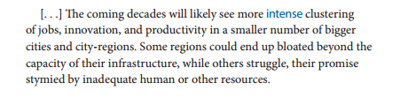
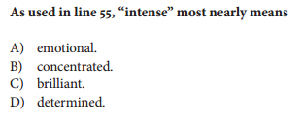
New SAT Reading – Vocabulary in context
More common words tested in uncommon ways.

Slide 29
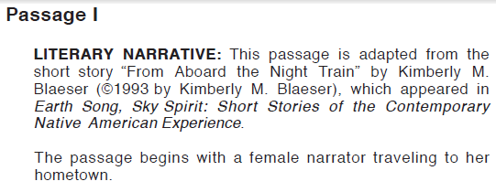
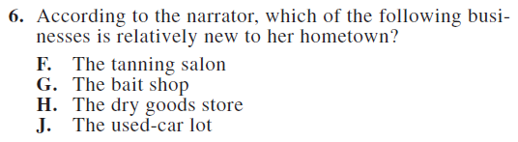
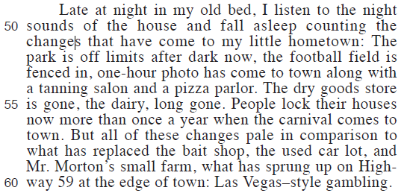
ACT Reading
Notes:
From preparing for the ACT 2014 page 36

Slide 30
New SAT Reading

Slide 31

English and Writing

Slide 32
Grammar Rules - Same ‘ole same
Grammar Rules | ACT | New SAT
Verbs | ✓ | ✓
Pronouns | ✓ | ✓
Adjectives/Adverbs | ✓ | ✓
Comparisons |  | ✓
Punctuation | ✓ | ✓
Modifiers
Notes:
The rules covered by the 3 tests overlap greatly

Slide 33

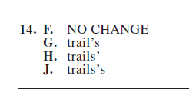
ACT – Grammar in context

Slide 34
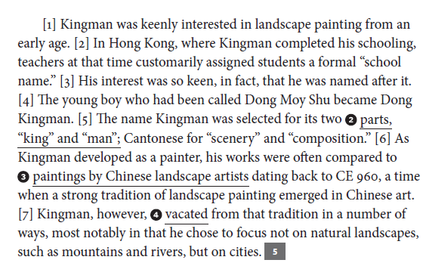
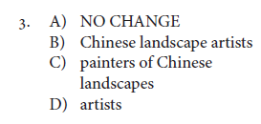
New SAT – Grammar in context

Slide 35
Changes to the essay
 | ACT | New SAT
Time allotted | 40 mins | 50 Mins
Optional | ✓ | ✓
Make an argument | ✓
Analyze an argument | ✓ | ✓
Scored separately | ✓ | ✓
A big factor in admissions
We recommend that all students take the Essay in case a school they want to apply to requires it.

Slide 36

Science

Slide 37

ACT Science

Slide 38
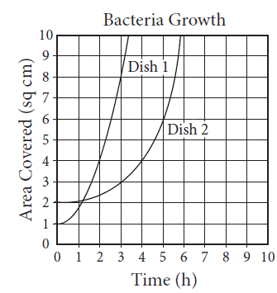
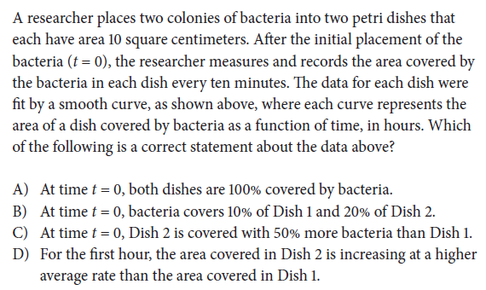
New SAT Science

Slide 39


Testing Dates
ACT
SAT
rSAT
Feb*
April
June
September
October
December
May
June
October
November
December
January 2016
March 2016
May
June
October
November
December
January
Planning for and scheduling college admission testing is key.

Slide 40

We Got You!

Slide 41
Chris Piane
Executive Director
Chris.Piane@review.com

